Slide 1
Deep Learning
Morteza Maleki
1403 - Esfand
Some slides adopted from the MIT deep learning course taught by Aminis
https://introtodeeplearning.com/

Slide 2
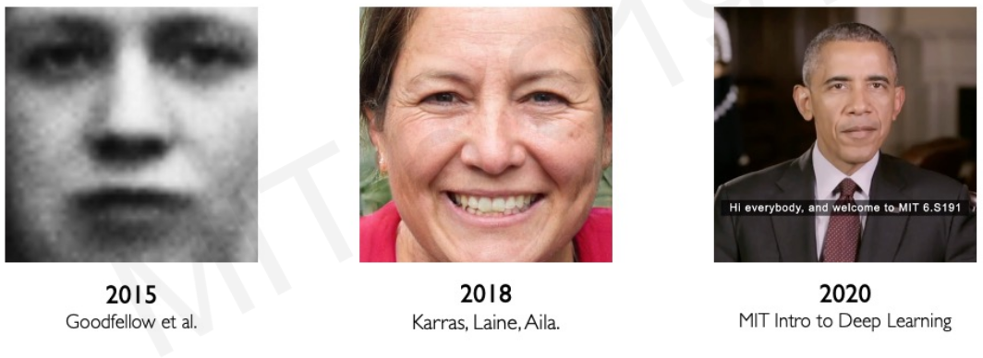
Deep learning progress

Slide 3
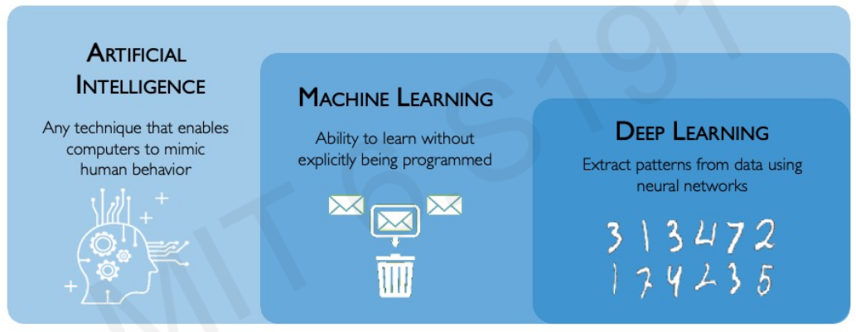
What is deep learning?

Slide 4
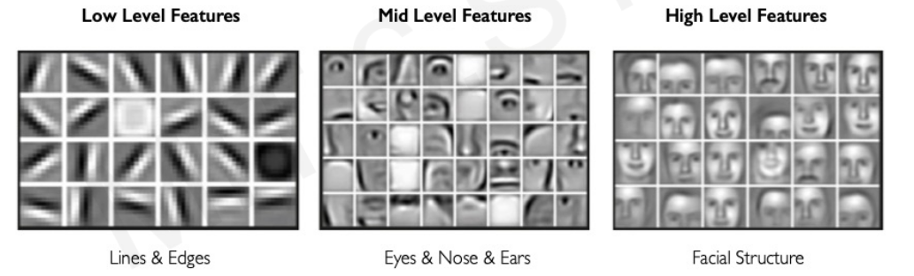
Why deep learning?

Slide 5
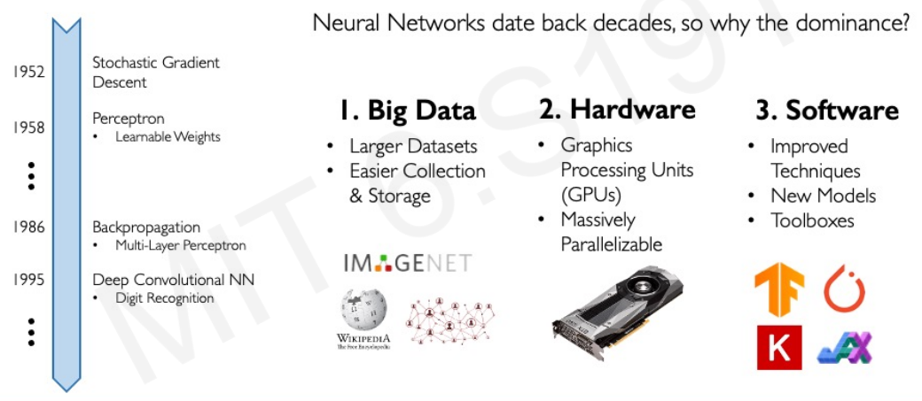
Why now?

Slide 6
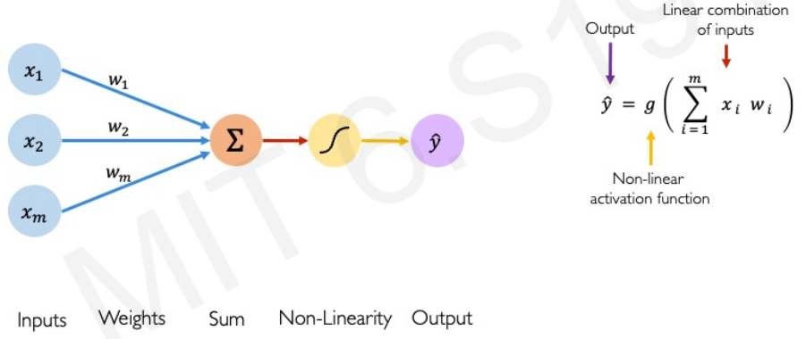
The perceptron

Slide 7
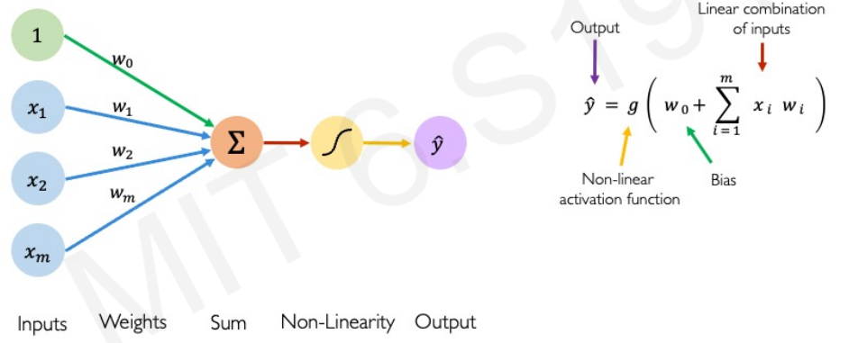
Forward propagation

Slide 8
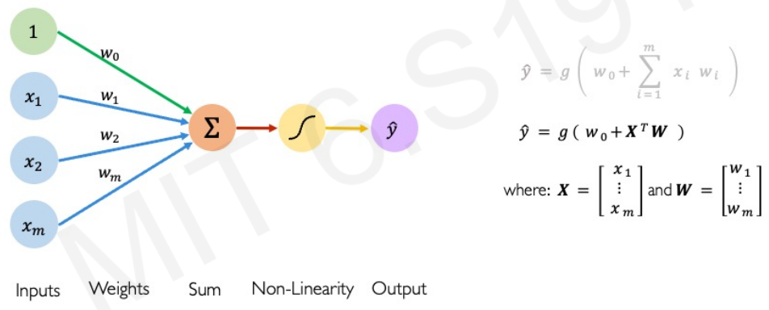
Forward propagation

Slide 9
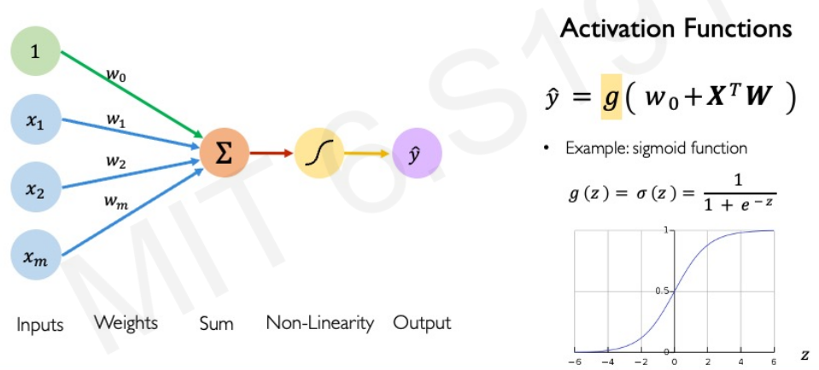

Slide 10
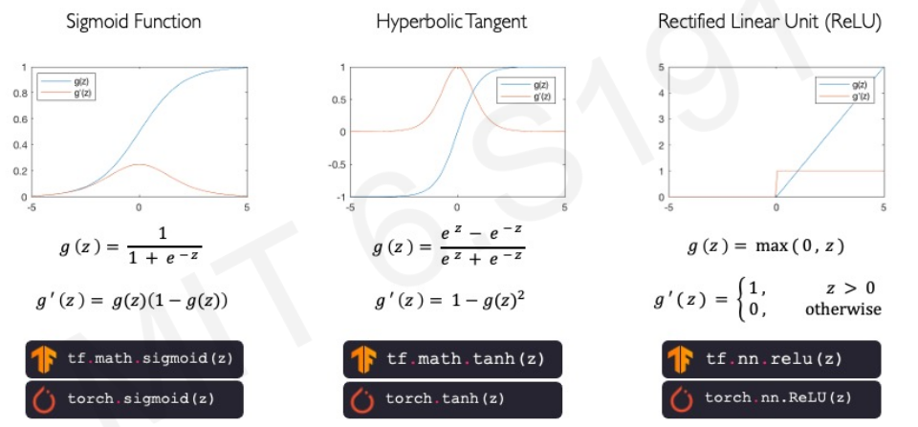
Common activation functions

Slide 11
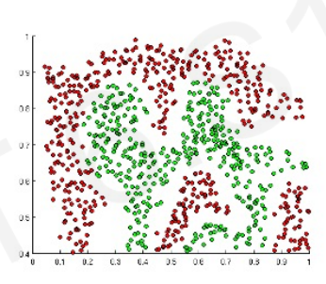
Importance of activation functions
introduce non-linearity

Slide 12
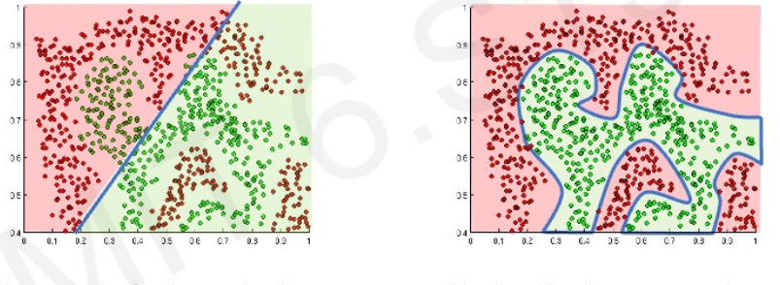
Linear functions

Slide 13
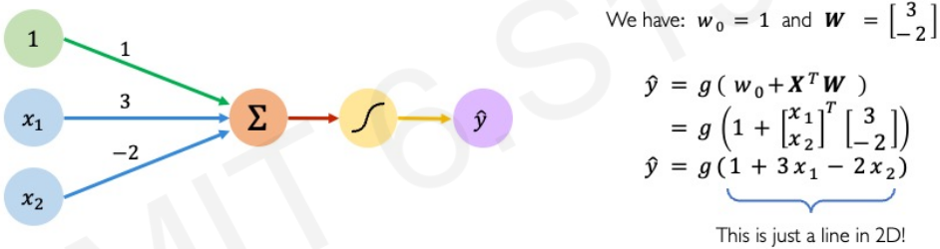
The perceptron: example

Slide 14
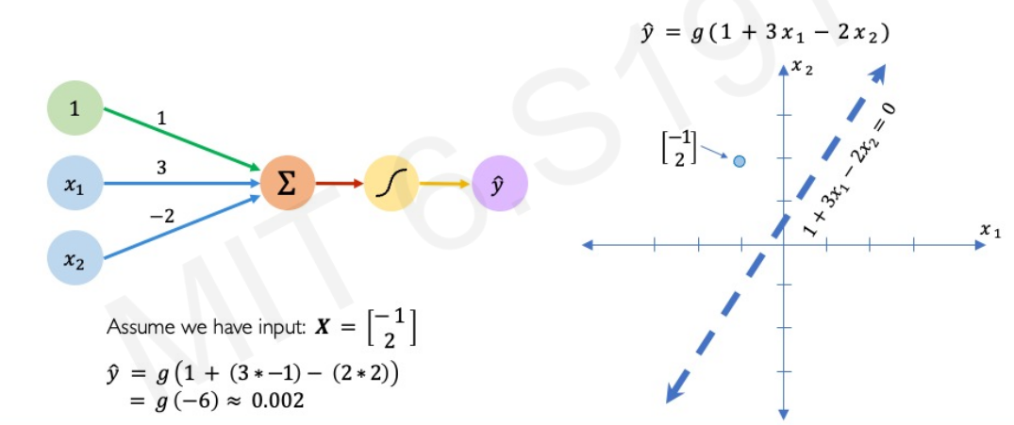

Slide 15
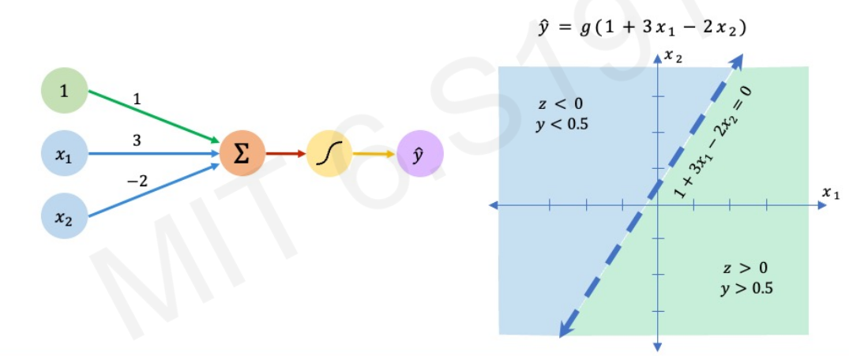

Slide 16
Building Neural Networks with perceptron

Slide 17
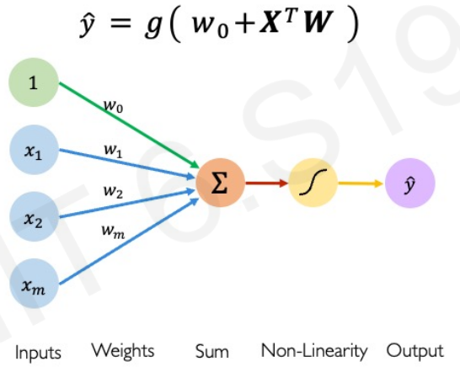

Slide 18
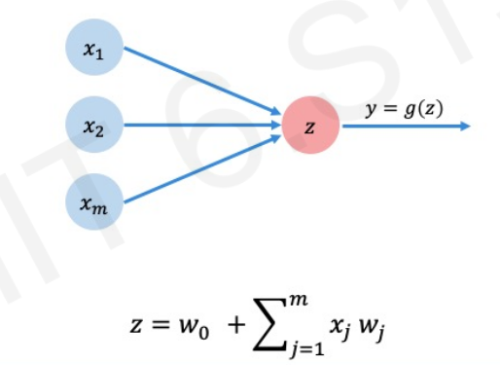

Slide 19
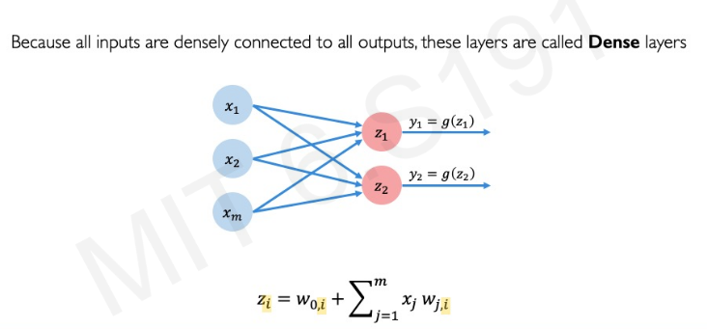
Multi Output Perceptron

Slide 20
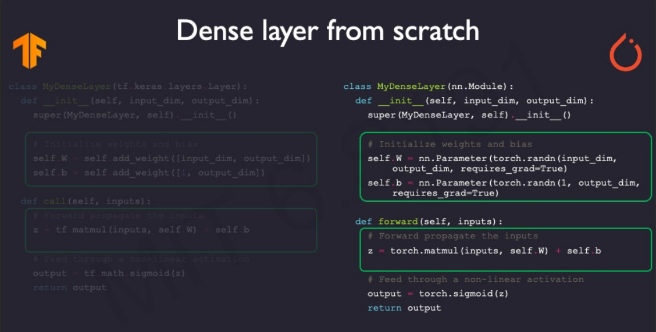

Slide 21
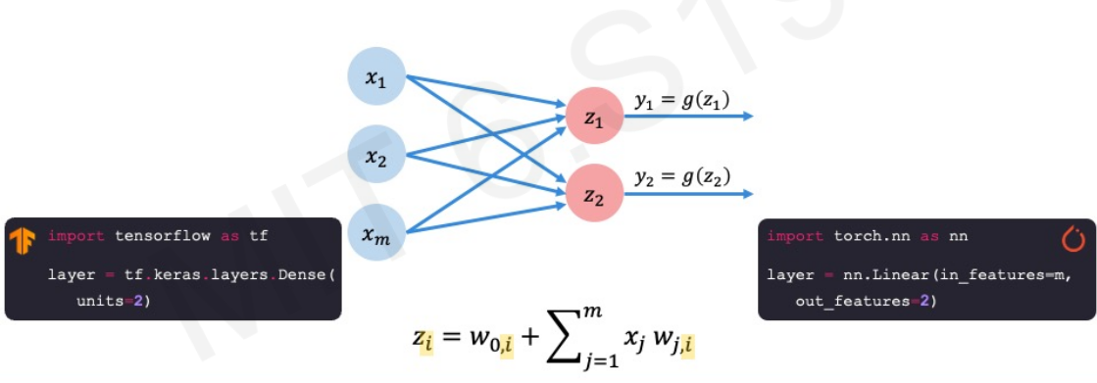

Slide 22
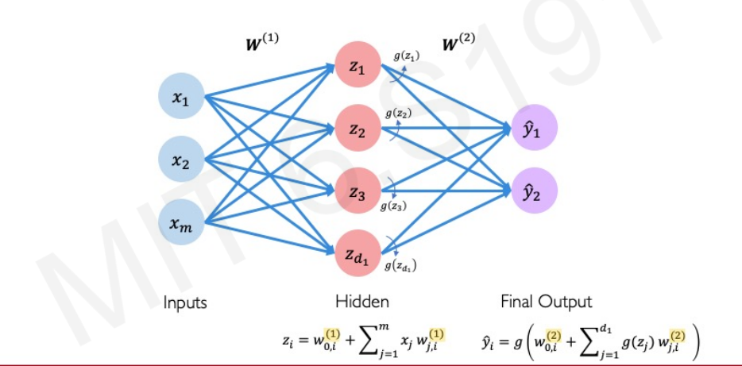
Single Layer NN

Slide 23
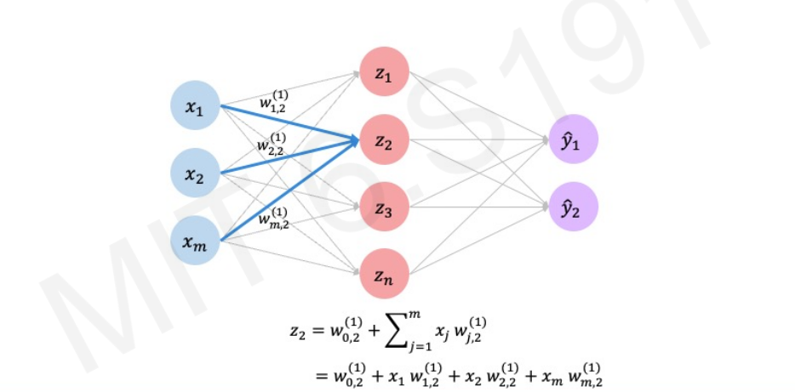
Single Layer NN

Slide 24
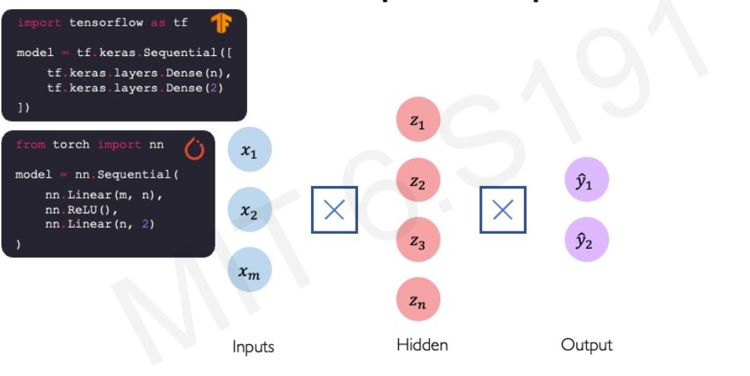
Multi output Perceptron

Slide 25
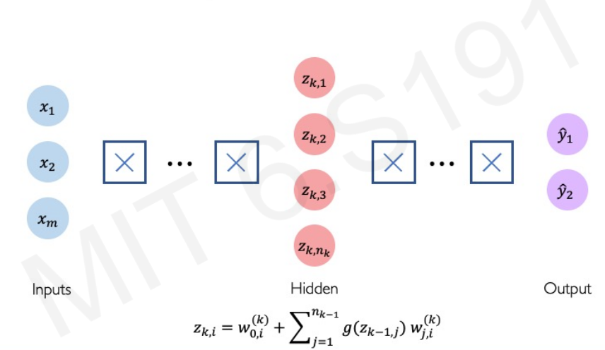
Deep Neural Network

Slide 26
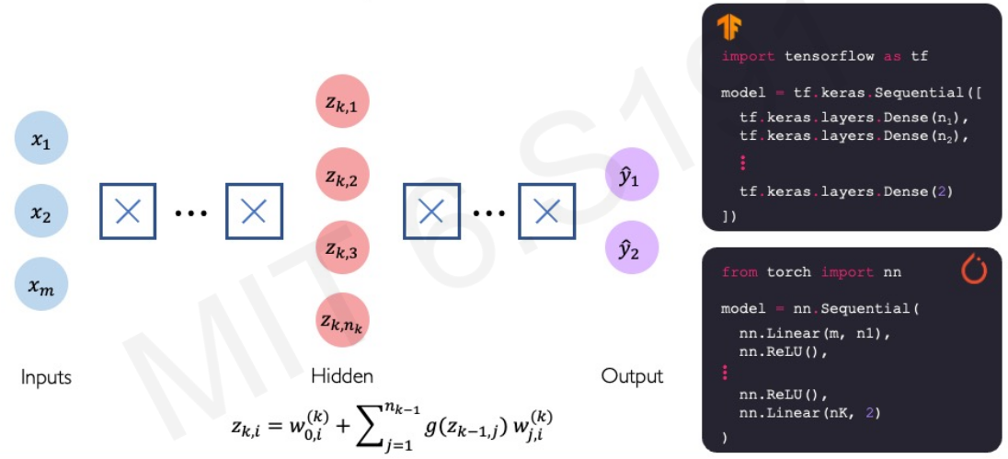
Deep Neural Network

Slide 27
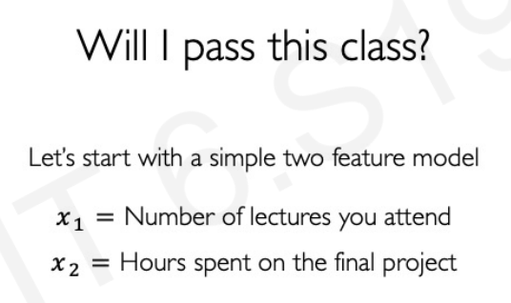
Apply NN

Slide 28
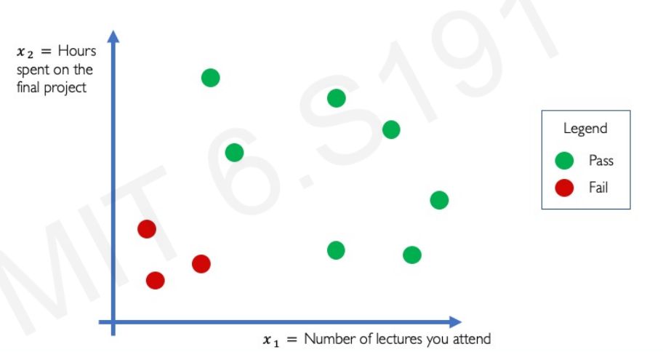
Will I pass the class?

Slide 29
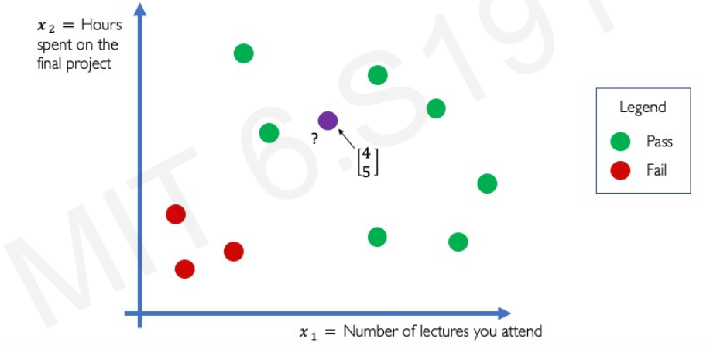
Will I pass the class?

Slide 30
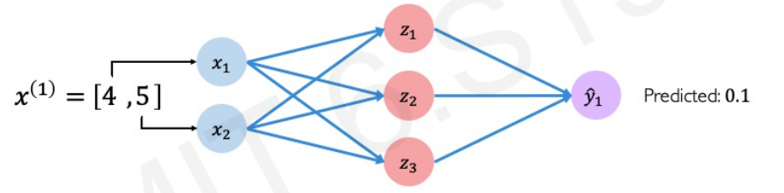
Will I pass the class?

Slide 31
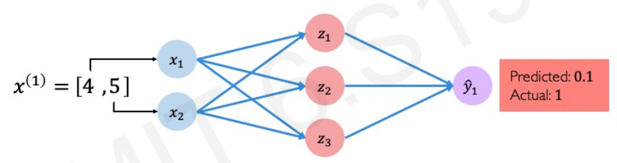

Slide 32
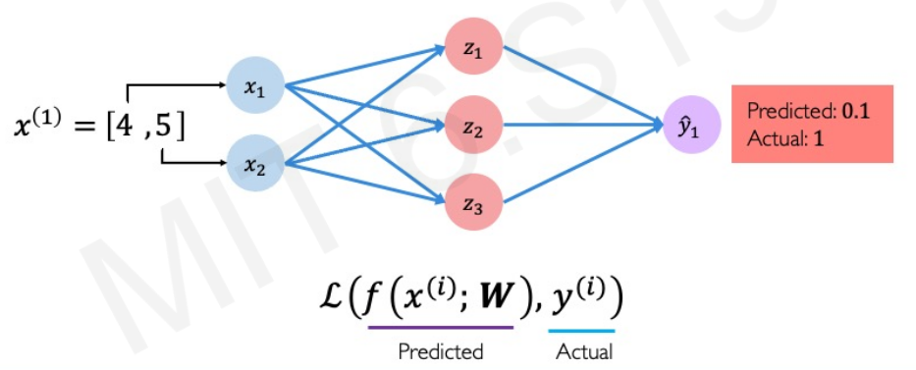
Quantifying Loss

Slide 33
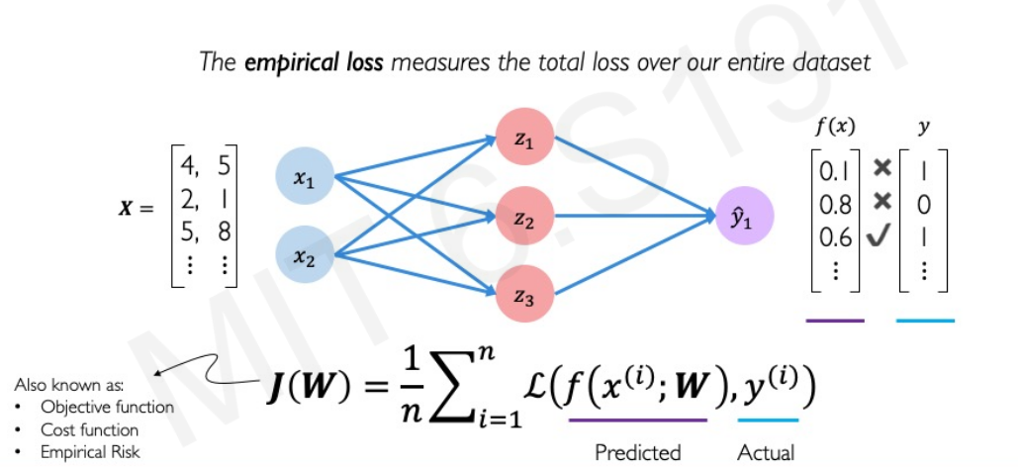
Empirical Loss

Slide 34
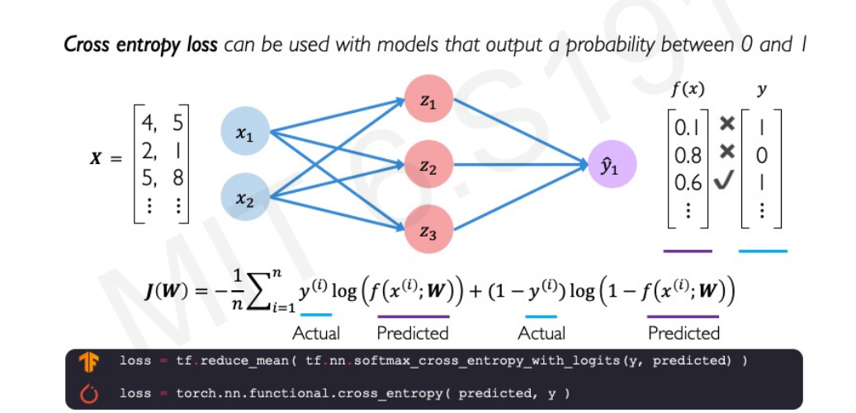
Binary Cross Entropy

Slide 35
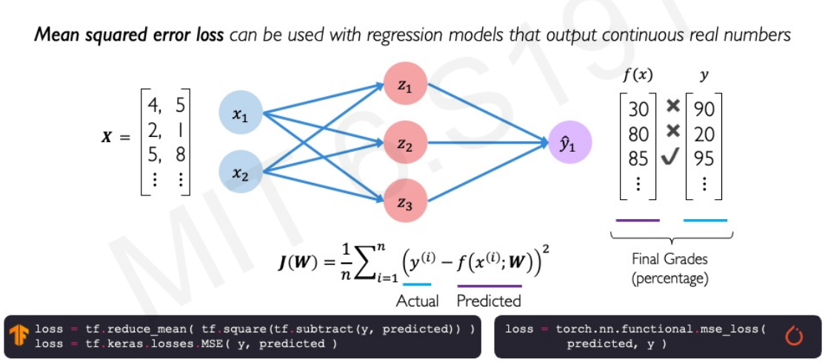
Mean Squared Error Loss

Slide 36
Training NN

Slide 37
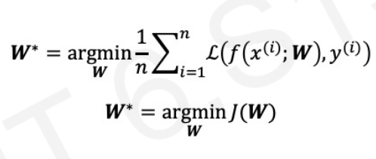
Loss Optimization

Slide 38
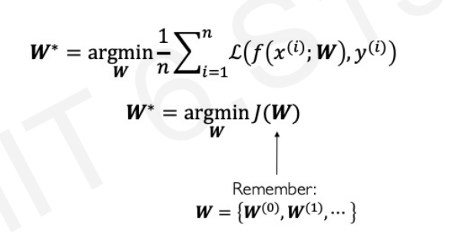
Loss Optimization

Slide 39
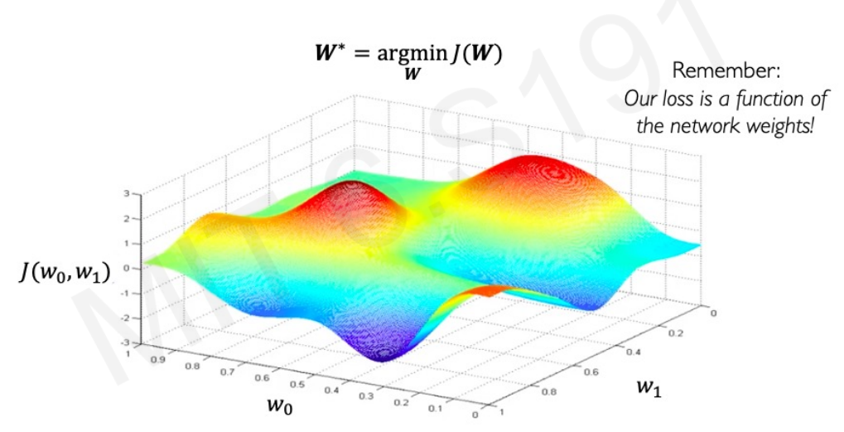
Loss Optimization

Slide 40
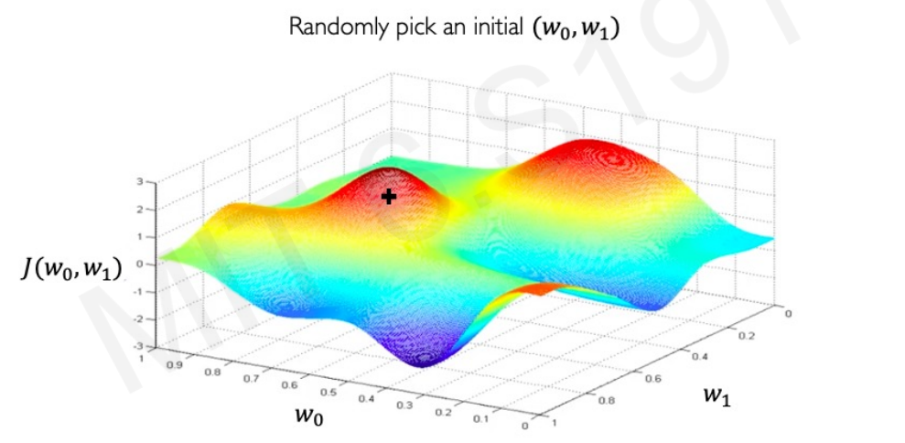
Loss Optimization

Slide 41
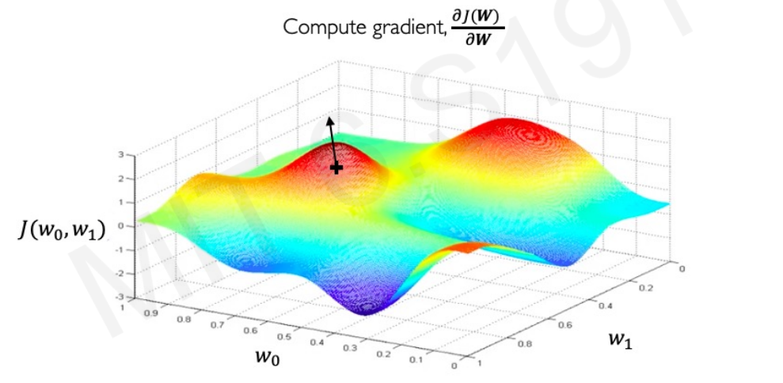
Loss Optimization

Slide 42
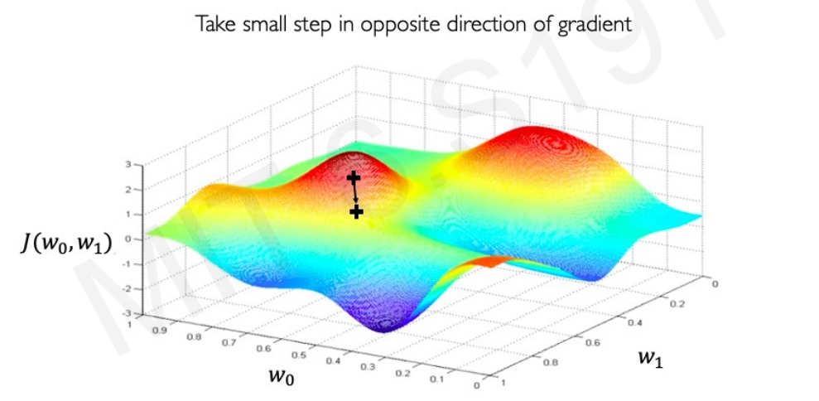

Slide 43
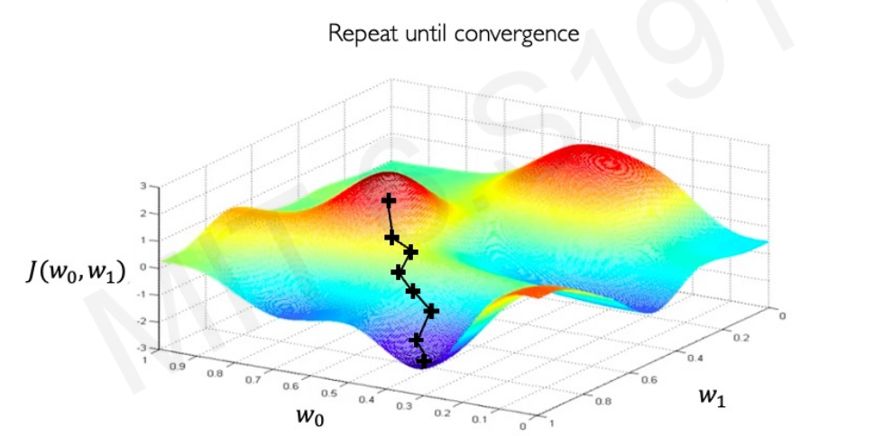

Slide 44
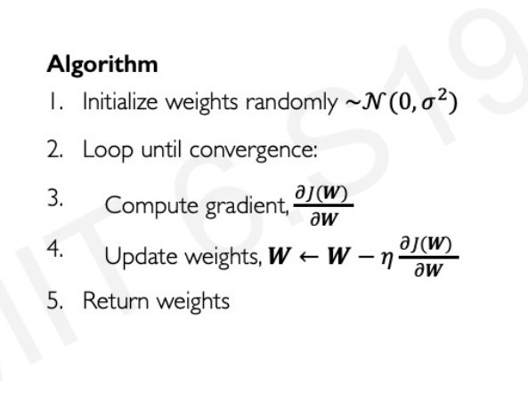
Gradient Descent

Slide 45
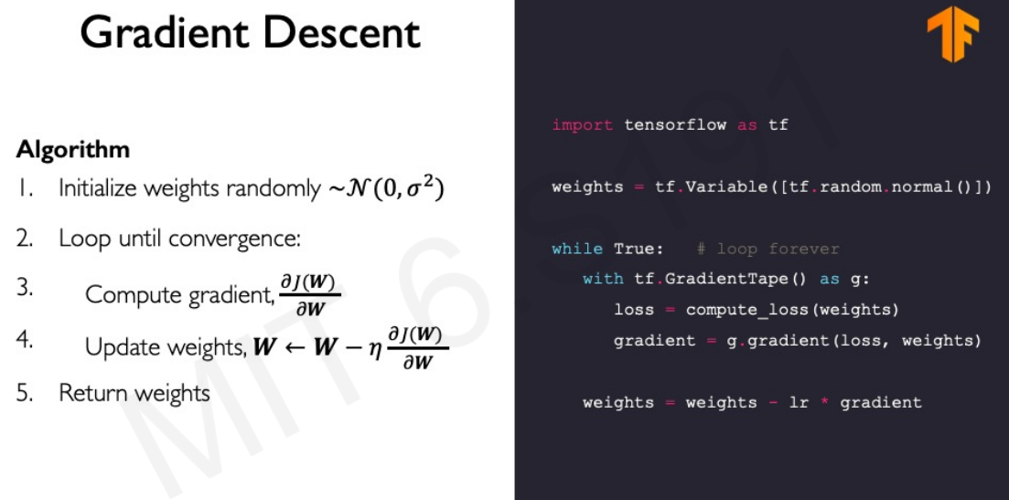

Slide 46
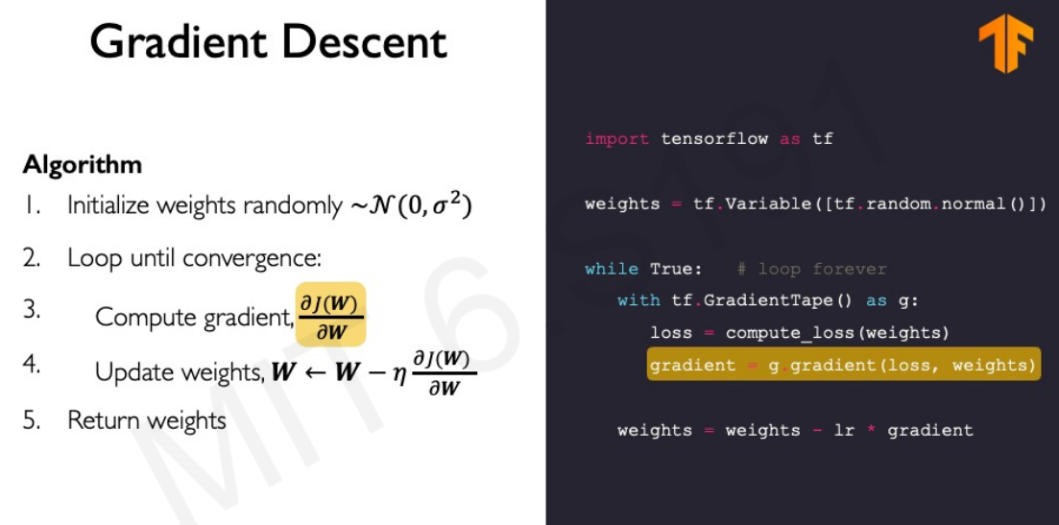

Slide 47
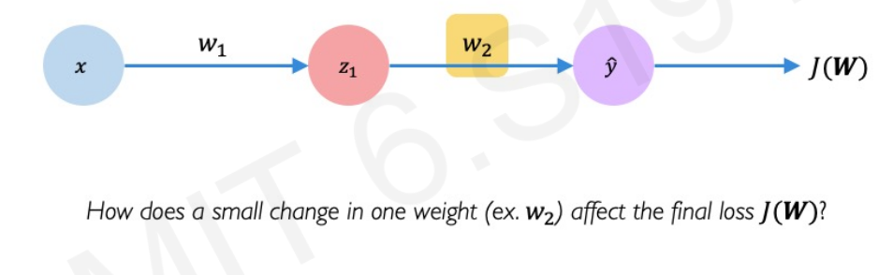
Computing Gradients: Backpropagation

Slide 48
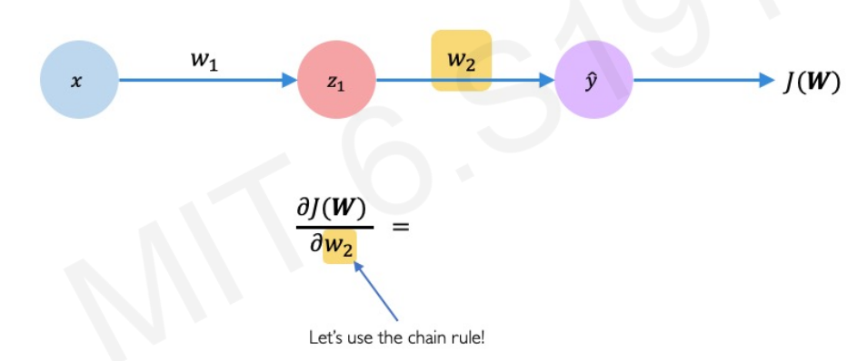
Computing Gradients: Backpropagation

Slide 49
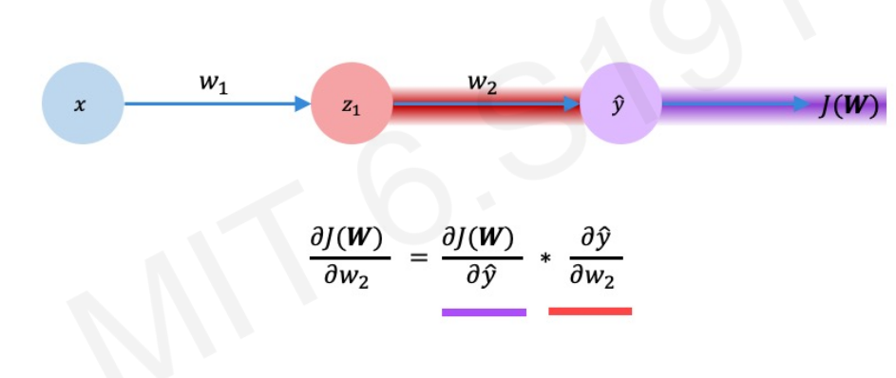
Computing Gradients: Backpropagation

Slide 50
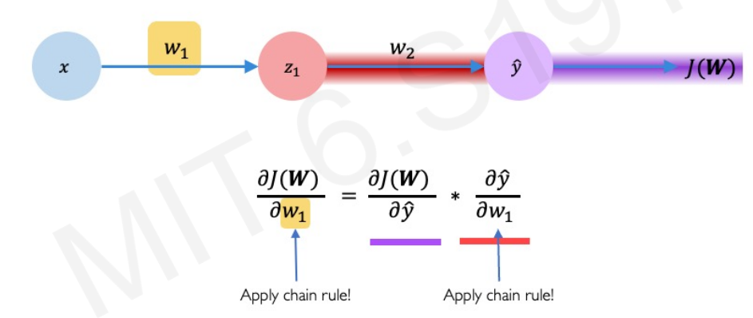
Computing Gradients: Backpropagation

Slide 51
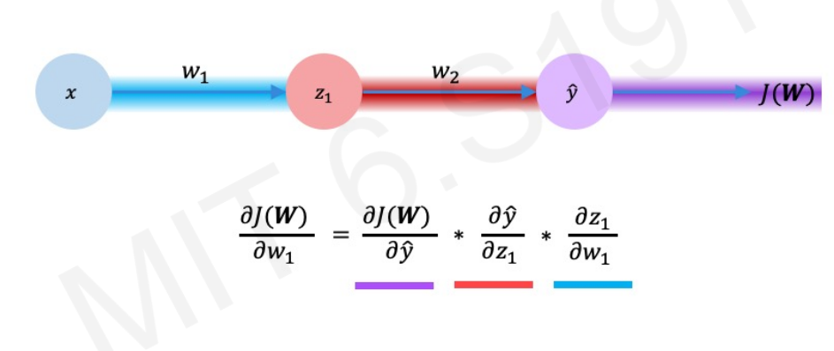
Computing Gradients: Backpropagation

Slide 52
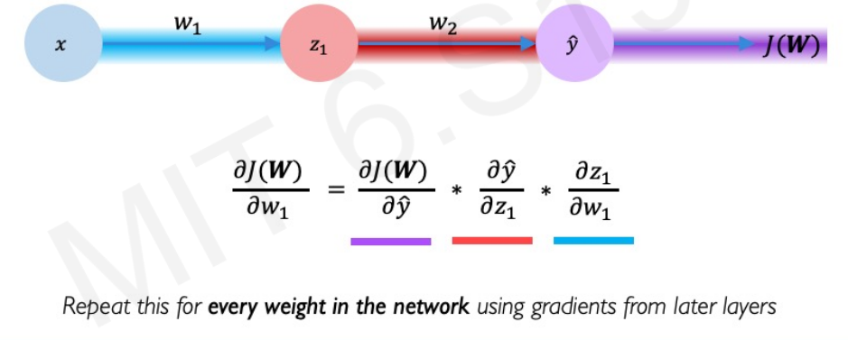
Computing Gradients: Backpropagation

Slide 53
Optimization

Slide 54
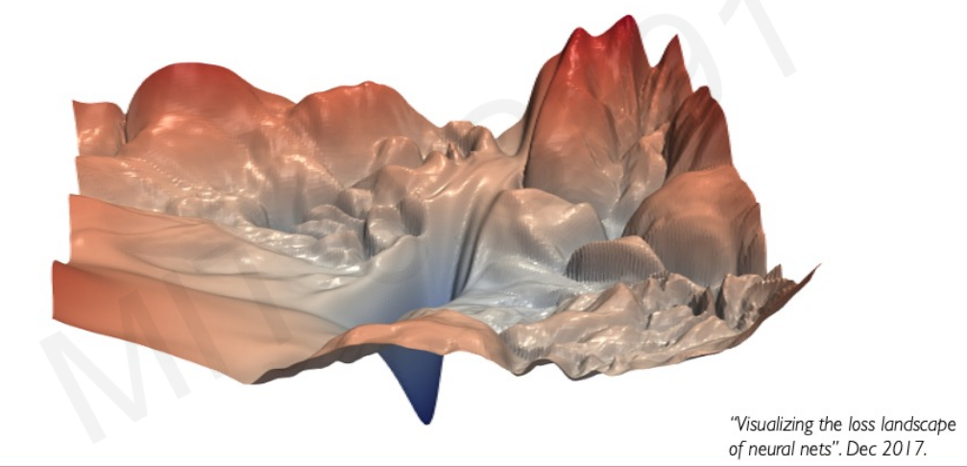
Training Neural Network is difficult

Slide 55

Loss Function can be Difficult to Optimize

Slide 56

Loss Function can be Difficult to Optimize

Slide 57

Setting the Learning Rate

Slide 58

Setting the Learning Rate

Slide 59

Setting the Learning Rate

Slide 60

How to deal with this?

Slide 61

How to deal with this?

Slide 62

Adaptive Learning Rate

Slide 63

Gradient Descent Algorithms

Slide 64


Slide 65
Neural Networks In practice: mini-batches

Slide 66

Gradient Descent

Slide 67

Gradient Descent

Slide 68

Stochastic Gradient Descent

Slide 69

Stochastic Gradient Descent

Slide 70

Stochastic Gradient Descent

Slide 71


Slide 72


Slide 73

Overfitting

Slide 74

Regularization

Slide 75

Regularization

Slide 76

Regularization 1: Dropout

Slide 77

Regularization 1: Dropout

Slide 78

Regularization 1: Dropout

Slide 79

Regularization 2: Early Stopping

Slide 80


Slide 81


Slide 82


Slide 83


Slide 84


Slide 85


Slide 86


